Slide 1
Analysis of Sperm– the number game
Ms. Saranya Mithraprabhu
Senior Embryologist
Womens Center
Coimbatore, Trichy, Chennai

Slide 2
What are we looking at
Sperm analysis – New WHO standards
Genetics of male infertility
Sperm Biomarkers tests – beyond routine sperm analysis
Assisted Reproductive Techniques

Slide 3
Cut-off values for Semen parameters as published in consecutive WHO manuals
Semen parameters | WHO 1980 | WHO 1987 | WHO 1992 | WHO 1999 | WHO 2010
Volume (ml) | ---- | > or = 2 | > or = 2 | > or = 2 | 1.5
Conc. | 20-200 | > or = 20 | > or = 20 | > or = 20 | 15
Total conc. | ----- | > or = 40 | > or = 40 | > or = 40 | 39
Total motility | > or = 60 | > or = 50 | > or = 50 | > or = 50 | 40
PR motility | > or = 2 | > or = 25% | > or = 25% (a) | > or = 25% (a) | 32% (a+b)
Vitality (%) | ---- | > or = 50 | > or = 75 | > or = 75 | 58
Morphology | 80.5 | > or = 50 | > or = 30 | 14 | 4
Leukocyte | <4.7 | <1.0 | <1.0 | <1.0 | <1.0

Slide 4
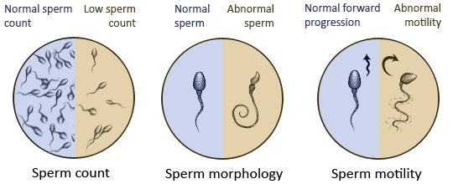
Sperm Analysis – WHO, 5th edition, 2010
Sperm conc. 15 M/ml
Total motility 40%
Progressive motility 32% (a+b)
Vitality 58%
Morphology 4%
‘Abnormal’ results WHO 1999 reclassified as
‘Normal’ results WHO 2010

Slide 5
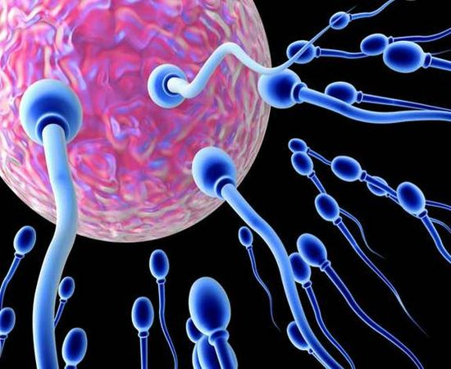
Motility grading – WHO 5th edition, 2010
Progressive motility (PR)
Sperm moving actively, regardless of speed
Non – progressive motility (NP)
Absence of progression
Immotile (IM)
No movement
Motility grading as a,b,c,d in WHO 4th edition – changed to PR, NP and IM in WHO 5th edition

Slide 6
Sperm morphology - assessments
Kruger strict criteria for morphology evaluation
Shape of sperm
Acrosome (40% - 70% of sperm head)
Only specialized andrology laboratories can perform strict evaluation
Stained sperm (size, head shape, mid piece, tail and other abnormalities) are examined under oil at 100X power

Slide 7
Sperm function – predictive assessments
Total motile sperm count
Sperm no. in the entire ejaculate
Total functional motile sperm count
No. of functionally competent sperm
Teratozoospermic Index
No. of abnormalities present per abnormal spermatozoon
Sperm deformity Index
Multiple structural deformities
Critical to assess the male fertility potential

Slide 8
Functional motile sperm count - Interpretation
Procedure | Ranges (per ejaculate)
IUI | 5 – 10 M/ejaculate
IVF | >0.3 M/ejaculate
ICSI | <0.3 M/ejaculate
No. of functionally competent sperm

Slide 9
Teratozoopsermic Index- Interpretation
Procedure | Teratozoospermic Index
IUI | < 1.5
IVF / ICSI | > 1.5
Poor fertility prognosis | > or = 3.0
No. of abnormalities present per abnormal spermatozoon

Slide 10
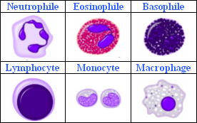
Leucoscreen
Excessive presence indicates reproductive tract infection – Leucocytospermia
This is associated with reductions in the
Ejaculate volume
Sperm concentration
Sperm motility
Loss of sperm function as a result of oxidative stress
Threshold value
< or = 5x10⁶ M/ml of round cells
< or = 1x10⁶ M/ml of leucocytes
Differentiates white blood cells from other round cells

Slide 11
Sperm analysis – Basic model Jonge 2012
Reference book – WHO manual
Non-adherence to the standardized protocols
Non-compliant laboratories generate data that may not be relevant for comparison with reference values where standardized protocols have been adhered to
Sperm analysis has its own limitations

Slide 12
What are we looking at
Sperm analysis – New WHO standards
Genetics of male infertility
Sperm Biomarkers tests – beyond routine sperm analysis
Assisted Reproductive Techniques

Slide 13
Sperm analysis : Limitations Bungam et al., 2011
Predictive value in relation to achieving spontaneous pregnancy is poor
Predictive value in relation to the choice of ART technique is limited
Poor link between the pathogenesis and the diagnosis of sperm evaluation
Male infertility evaluation – much more than a simple sperm analysis

Slide 14
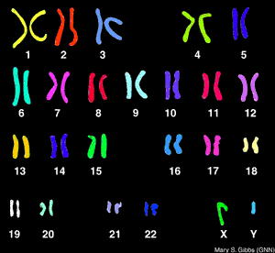
Genetics of male infertility
Genetic etiology for reproductive failure
Azoospermia
Severe oligozoospermia
Azoospermia
Non-obstructive (Cystic Fibrosis)
Obstructive (Y chromosome deletions)
Karyotyping as part of pre-treatment screening for <5.0M/ml sperm concentration

Slide 15
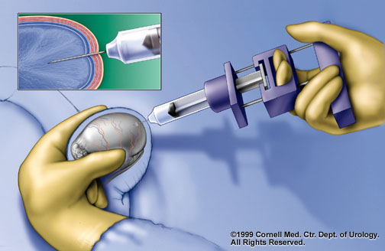
Obstructive / Non-obstructive Azoopsermia
Obstructive Azoospermia
Congenital Bilateral Absence of Vas Deferens (CBAVD) is the common cause
Spermatogenesis intact and can be retrieved from epididymis
Non-obstructive Azoospermia
Y chromosome deletions
AZF locus contains genes for spermatogenesis
AZFa, AZFb, AZFc

Slide 16
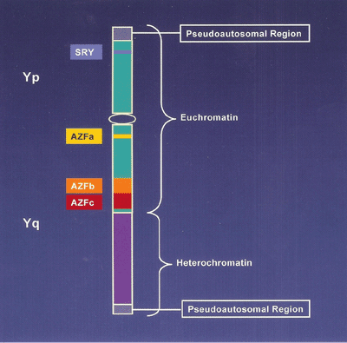
AZF microdeletions
AZFa and AZFb deletions
Spermatogenic failure (Sertoli Cell Syndrome) causing Azoospermia
Testicular sperm retrieval ineffective
AZFc deletions
Variable phenotype – mild Oligozoospermia to Azoospermia
Sperm retrieval from ejaculate (for oligozoospermia)
Testicular biopsy (for Azoospermia)
Y chromosome deletions at a much higher rate in infertile men than in fertile controls

Slide 17
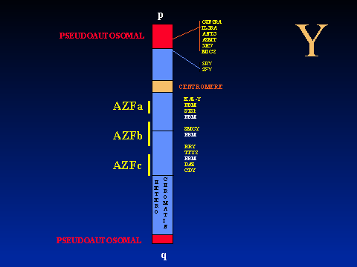
AZF microdeletions

Slide 18
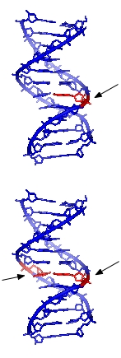
What are we looking at
Sperm analysis – New WHO standards
Genetics of male infertility
Sperm Biomarkers – beyond routine sperm analysis
Assisted Reproductive Techniques

Slide 19
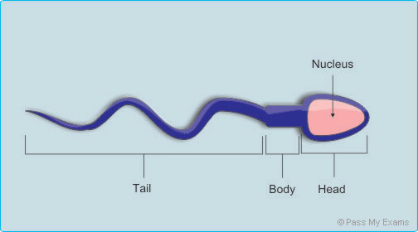
Sperm Biomarkers
Sperm analysis – fails to assess the genetic material present in the sperm head which transmits into the oocyte and embryo
Newer markers needed – to predict pregnancy outcome and risk of adverse outcome
Sperm DNA integrity – better measure of fertility potential
DNA fragmentation will reduce the sperm cells ability to produce a viable embryo

Slide 20
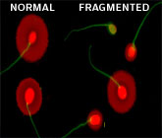
Role of sperm DNA – reproductive outcome
Fertilization involves
Fusion of the cell membrane
Union of the male and female gamete genomes
Sperm DNA integrity plays a role in
Fertilization process
Embryo development
Sperm DNA damage includes
DNA fragmentation
Abnormal chromatin packaging
Protamine deficiency
Ample clinical evidence to show that sperm DNA damage adversely affects reproductive outcome
Sperm DNA fragmentation inversely related to the sperm cells ability to produce a viable embryo

Slide 21
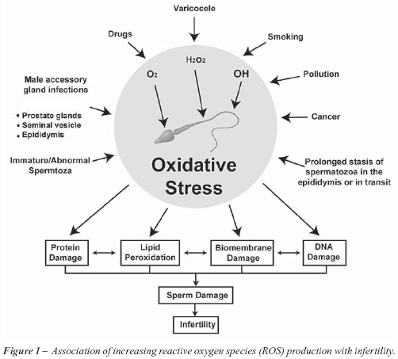
Mechanisms of Sperm DNA fragmentation
Apoptosis in Spermatogenesis
DNA strand breaks during remodelling of sperm chromatin during spermiogenesis
Post testicular DNA fragmentation via ROS, during sperm transport through seminiferous tubules and epididymis
Induced by
Endogenous caspases and endonucleases
Radio and chemotherapy
Environmental toxicants
Smoking

Slide 22
Sperm DNA fragmentation - Conditions
Idiopathic infertility
Persistent infertility after treatment of female
Recurrent miscarriage
Cancer in male: before and after treatment
Abnormal sperm analysis
Advancing male age (>50 years)

Slide 23
Sperm DNA fragmentation - Evaluation
Sperm Chromatin Structure Assay (SCSA)
Tdt-mediated-dUTP nick end labelling (TUNEL)
Single cell gel electrophoresis (COMET)
Sperm Chromatin Dispersion (SCD)
Acridine Orange test
Toluidine Blue Test
Oxidised deoxynucleoside
Chromomycin A3 staining
Annexin V-Binding Ability Assay
Evaluation of Anti- or Pro- Apoptotic Proteins

Slide 24
Sperm Chromatin Structure Assay
Gold standard method
Major tests applied for clinical evaluation
Over the last decade over 125 peer-reviewed research articles available to show the clinical relevance for DNA damage assessment

Slide 25
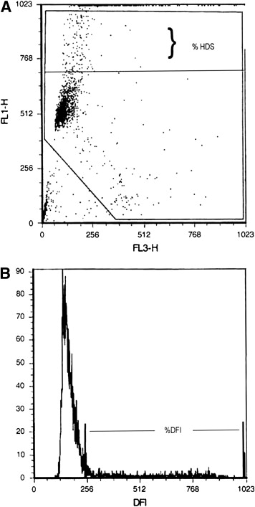
SCSA Principle Bungum et al., 2011
DNA Fragmentation Index (DFI) and % of Spermatozoa with abnormally High DNA Stainability (HDS) are calculated
DFI related to
Sperm with both single and double strand breaks
Impairment of normal protamination
HDS related to
Immature spermatozoa

Slide 26
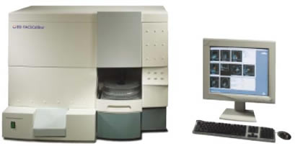
SCSA - Advantage
Availability of a standardized protocol
Adherence to the standardized protocol minimizes inter-laboratory variation
Precision Flow Cytometer used – measuring 1000’s of sperm rather than a 100

Slide 27
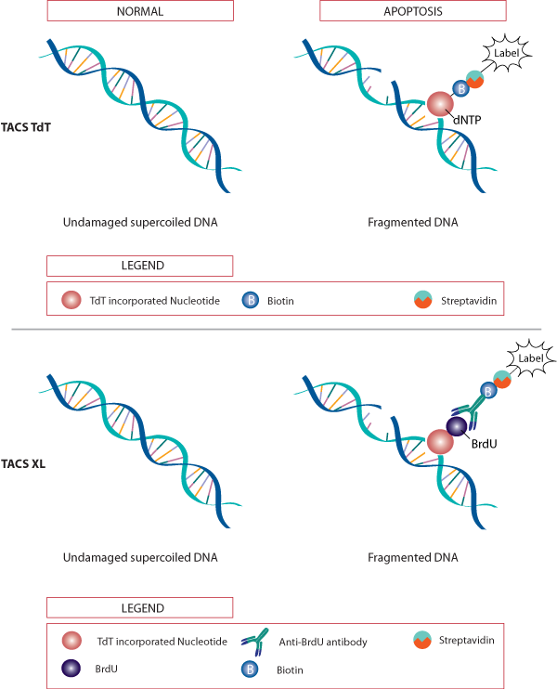
DNA Fragmentation Index - Interpretation
DNA damage
<15% - Normal sample
> 20% - Partly explains infertility problem
25 to 30% - Directly IVF/ICSI
>30% - ICSI to be considered

Slide 28
What are we looking at
Sperm analysis – New WHO standards
Genetics of male infertility
Sperm Biomarkers – beyond routine sperm analysis
Assisted Reproductive Techniques

Slide 29
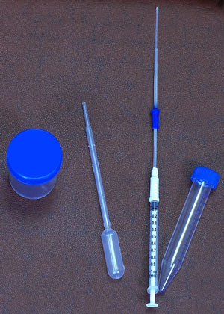
IUI – TFMSC and TZI
Do’s
Total functional motile sperm count
5 to 10 M/ejaculate
Teratozoospermic Index
<1.5
Dont’s
Total functional motile sperm count
<5 M/ejaculate
Teratozoospermic Index
>1.5 (poor fertility prognosis)
IUI not to be done with severe Oligoasthenoteratozoospermic samples

Slide 30
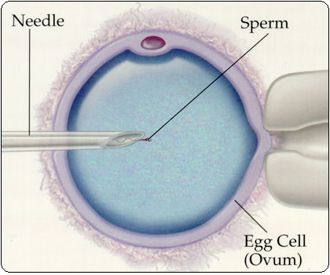
IVF/ICSI – TFMSC, TZI and DFI
Functional motile sperm count
>0.3 M/ej – IVF may be considered
< 0.3 M/ej – ICSI to be done
Teratozoospermic Index
>1.5 – directly IVF/ICSI
DNA Fragmentation Index
25 to 30% - directly IVF/ICSI
>30% - ICSI to be considered
Acts as a predictive factor in the choice of treatment modality required

Slide 31
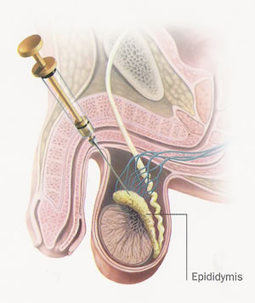
TESE - ICSI
Diagnostic TESE
Performed prior to IVF
Sperm viability and morphology assessed
Cryopreserved if sperm present
Therapeutic TESE
Performed on day of Oocyte retrieval
In some cases, cryopreserved TESE also used

Slide 32
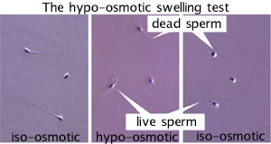
100% immotile sperm
Immotile sperm – can either be dead or live
Viability status at sperm analysis using eosin – nigrosin stain
Hypo Osmotic Swellling Test – used to select sperm during ICSI
First Women’s Center pregnancy with 100% immotile sperm achieved in 1999

Slide 33
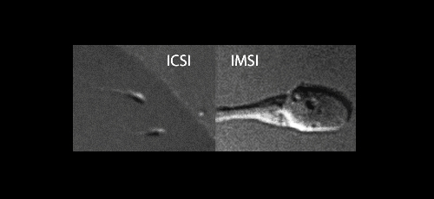
Intracytoplasmic Morphologically selected Sperm Injection (IMSI)

Slide 34
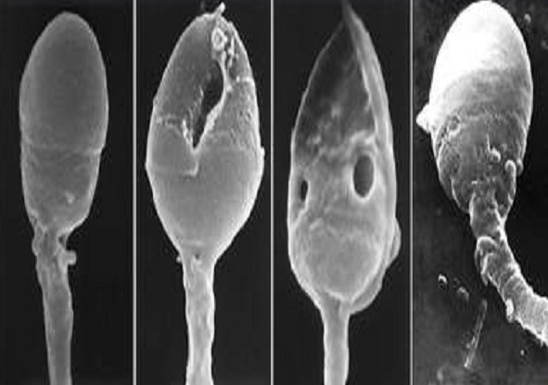
Intracytoplasmic Morphologically selected Sperm Injection (IMSI)
Type: | JPG

Slide 35
Thank you
Type: | JPG

